Slide 1
Predictive Analysis of ccpp-Energy Production
TEAM MEMBERS :-
PRAGATI
SHIVAKUMAR
SIMRAN
MANDEEP
KEERTHANA
RAKESH
Deepak.

Slide 2
Business Objective:
A combined-cycle power plant comprises gas turbines, steam turbines, and heat recovery steam generators. In this type of plant, the electricity is generated by gas and steam turbines combined in one cycle. Then, it is transferred from one turbine to another. We have to model the energy generated as a function of exhaust vacuum and ambient variables and use that model to improve the plant's performance.

Slide 3
Data Set Details:
This is a project where the variable to be predicted is energy production.
The data file contains 9568 observations with five variables collected from a combined cycle power plant over six years when the power plant was set to work with a full load.
The variables, or features, are the following:
Temperature, in degrees Celsius.
Exhaust_vacuum , in cm Hg.
Amb_pressure , in millibar. (Ambient pressure)
R_humidity, in percentage. (Relative humidity)
Energy_production, in MW, net hourly electrical energy output.

Slide 4
Additional Variable Information Features consist of hourly average ambient variables
- Temperature (T) in the range 1.81°C and 37.11°C,
Ambient Pressure (AP) in the range 992.89-1033.30 milibar,
Relative Humidity (RH) in the range 25.56% to 100.16%
Exhaust Vacuum (V) in teh range 25.36-81.56 cm Hg
Net hourly electrical energy output (EP) 420.26-495.76 MW. The averages are taken from various sensors located around the plant that record the ambient variables every second. The variables are given without normalization.

Slide 5
EXPLORATORY DATA ANALYSIS (EDA)

Slide 6
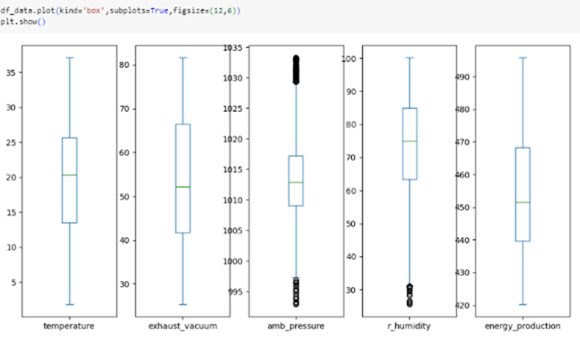
Data cleaning:-
There are Features which is in the Continous data.
- There Are 41 Duplicates.
- NO NUll Values.
- Outliers are detected and found in the Ambient Pressure and Relative humidity by using Matplotlib Boxplot.

Slide 7
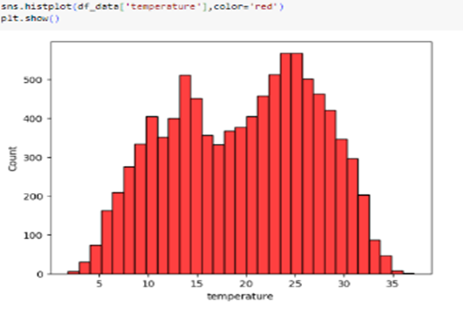
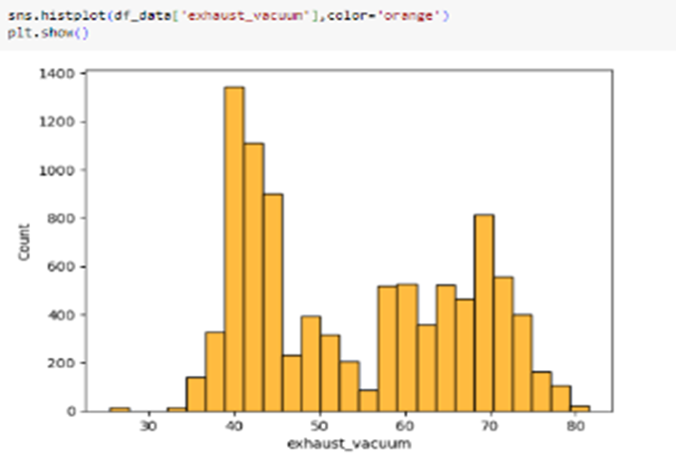
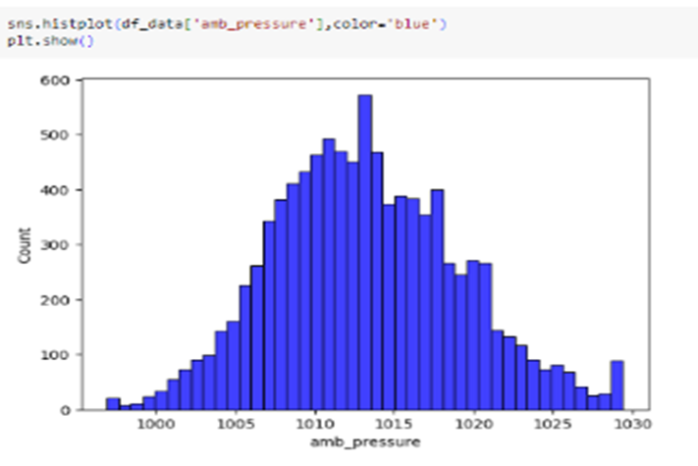
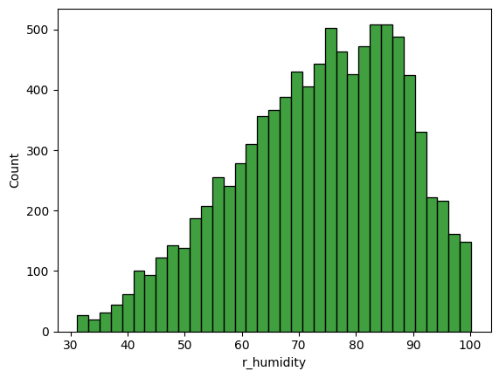
Data Visualization of each features :-
H I S T O G R A M

Slide 8
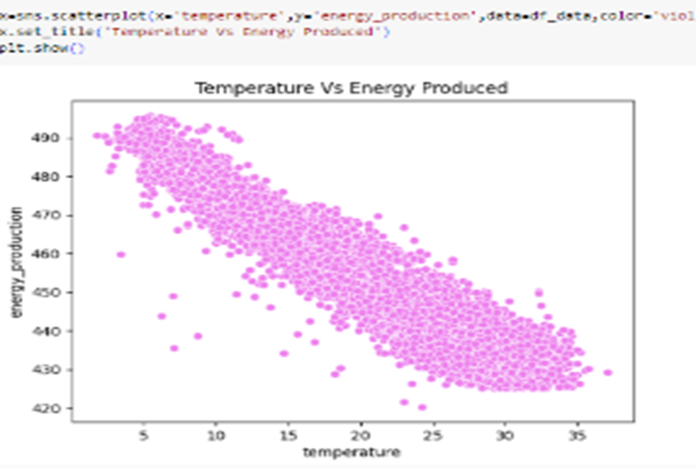
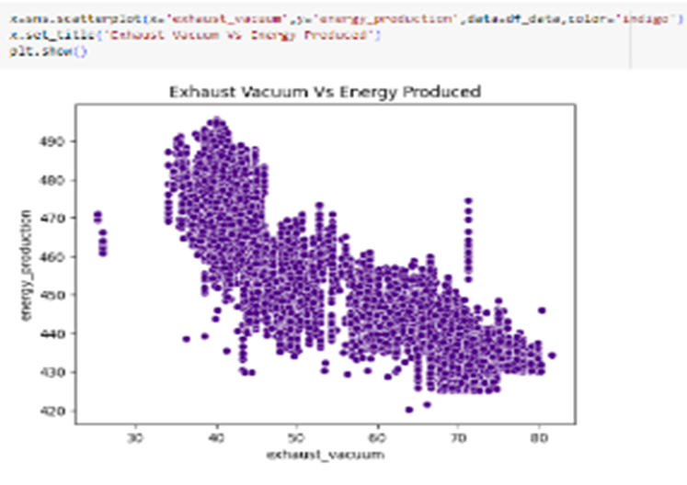
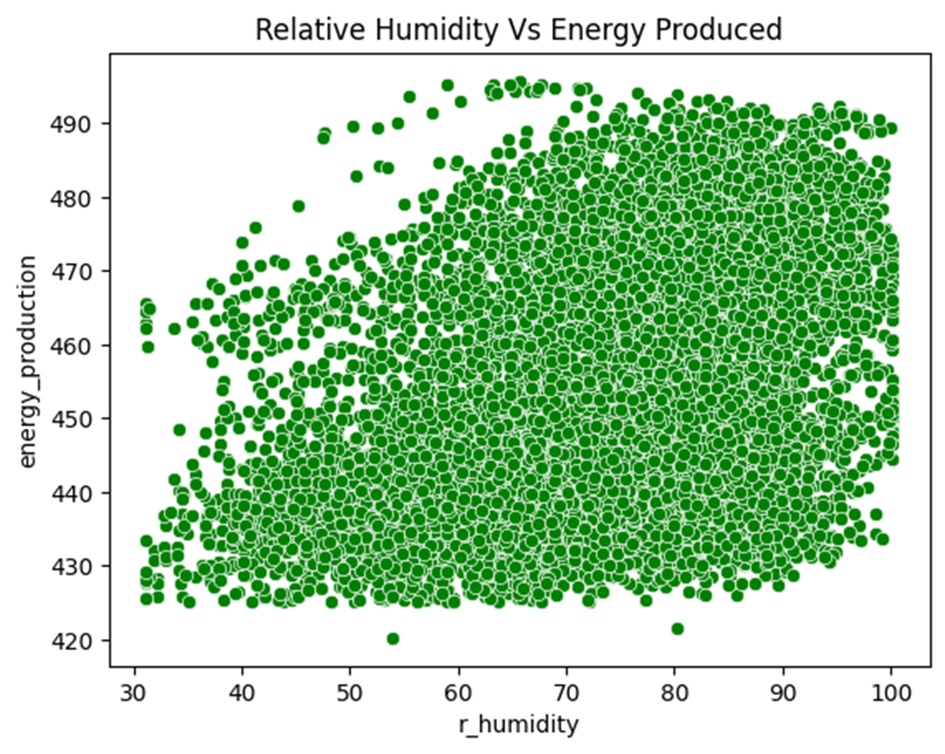
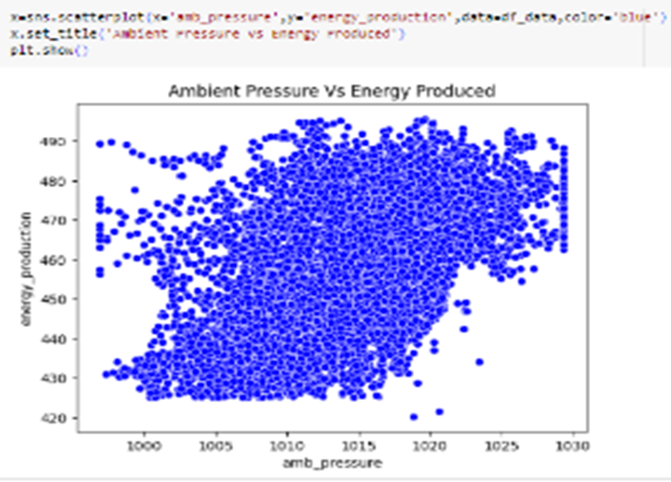
S C A T T E R P L O T

Slide 9
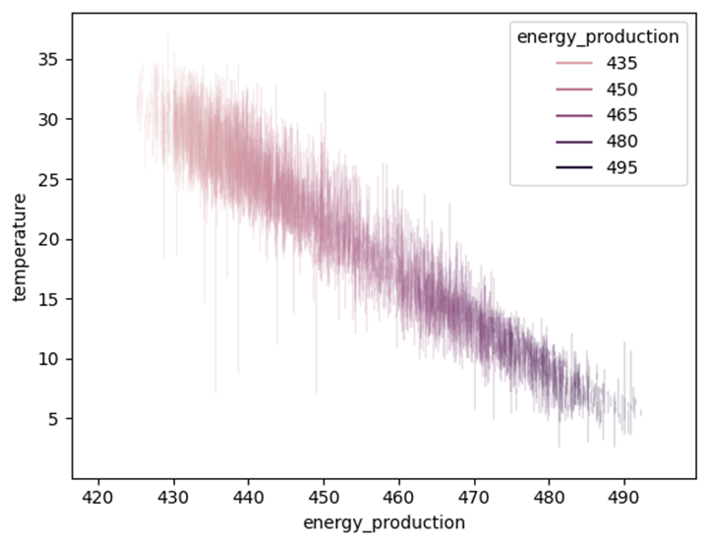
L I N E P L O T

Slide 10
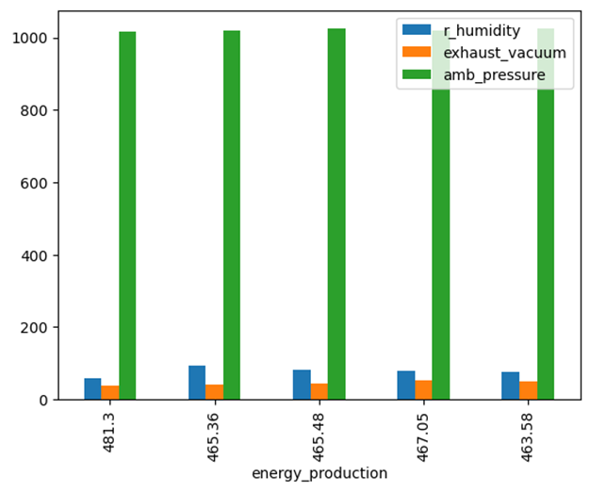
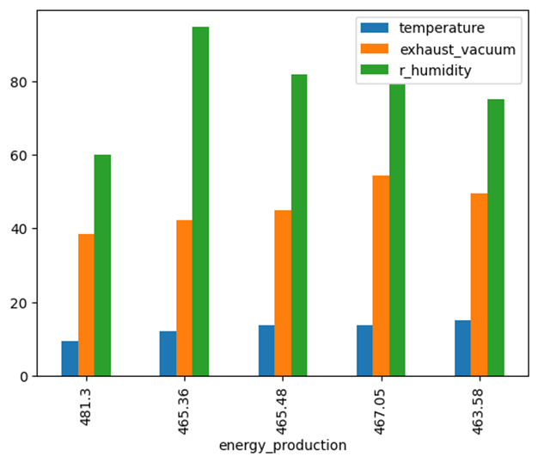
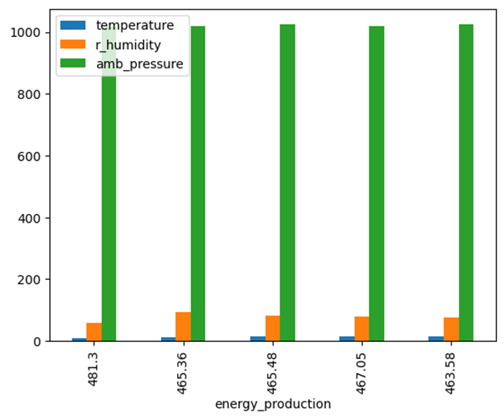
BAR CHART OF ENERGY PRODUCTION

Slide 11
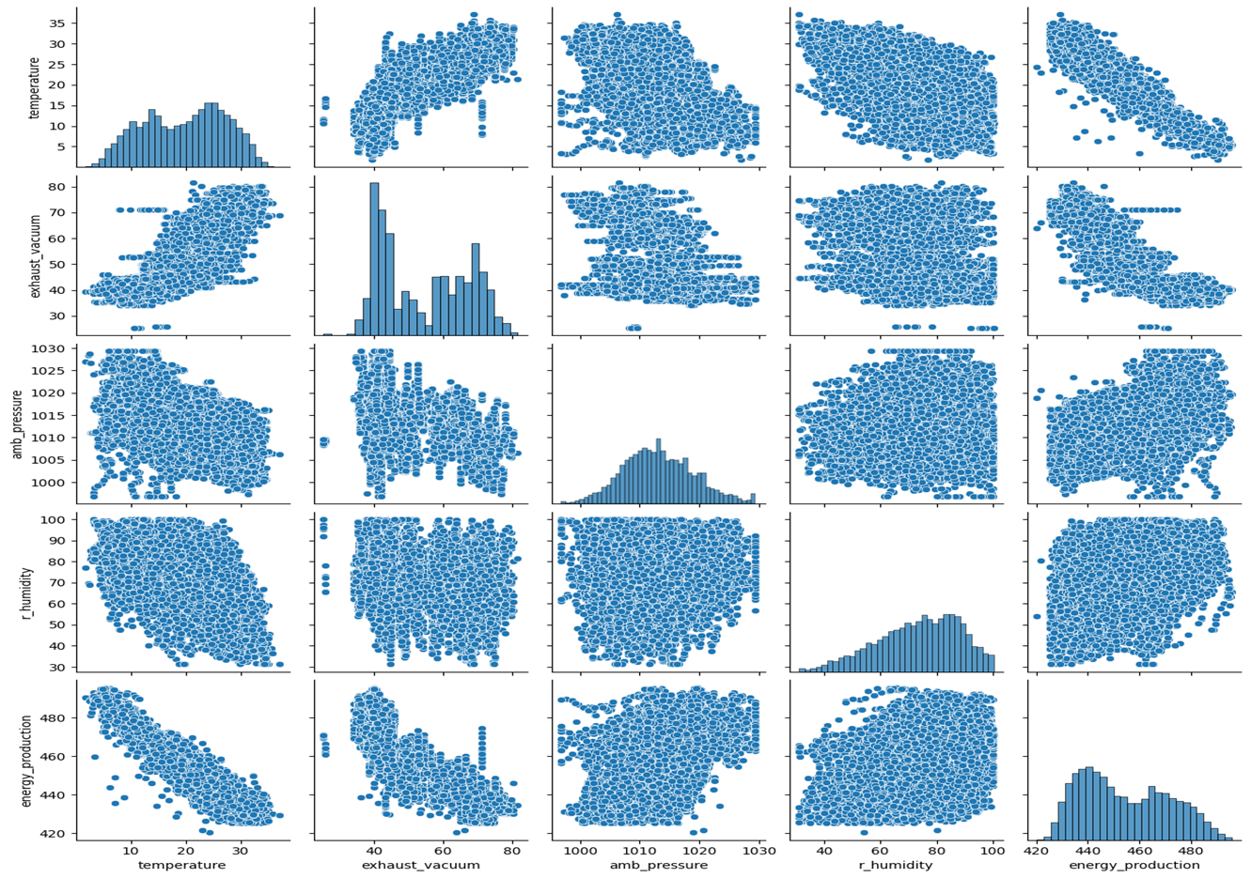
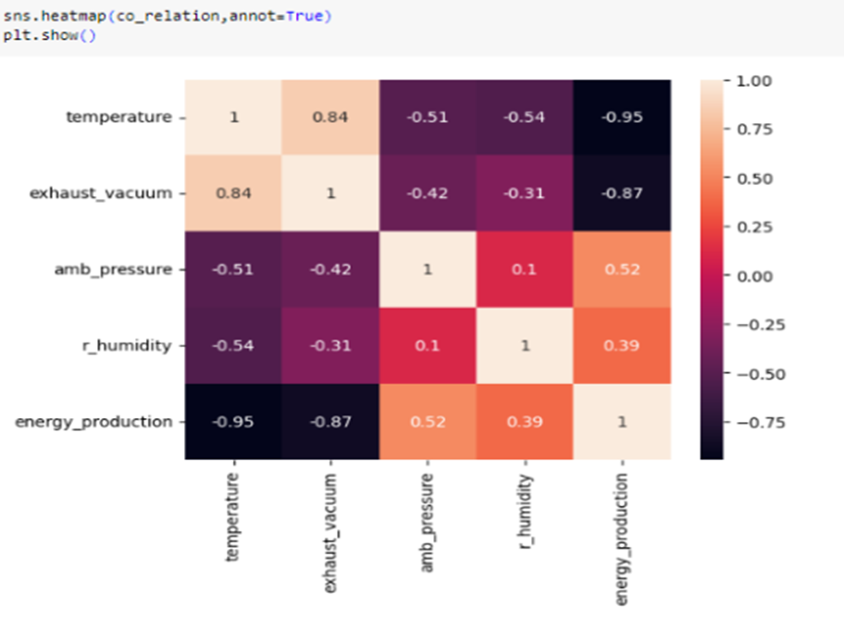
PAIR PLOT
HEATMAP

Slide 12
FEATURE - ENGINEARING

Slide 13
Feature Engineering with Univariate Feature Selection
Feature: temperature,
Score: 85097.75524592349
Feature: exhaust_vacuum,
Score: 29722.290856321124
Feature: amb_pressure,
Score: 3516.043164197852
Feature: r_humidity,
Score: 1713.8548285367515
Feature selection with Support Vector Regressor
Selected Features: Index ['temperature', 'exhaust_vacuum’]
Feature Ranking:
Feature: temperature, Rank: 1
Feature: exhaust_vacuum, Rank: 1
Feature: amb_pressure, Rank: 3
Feature: r_humidity, Rank: 2

Slide 14
Feature selection with Random Forest Regressor
Selected Features: Index(['temperature', 'exhaust_vacuum]
Feature Ranking:
Feature: temperature,
Rank: 1
Feature: exhaust_vacuum,
Rank: 1
Feature: amb_pressure,
Rank: 2
Feature: r_humidity,
Rank: 3

Slide 15
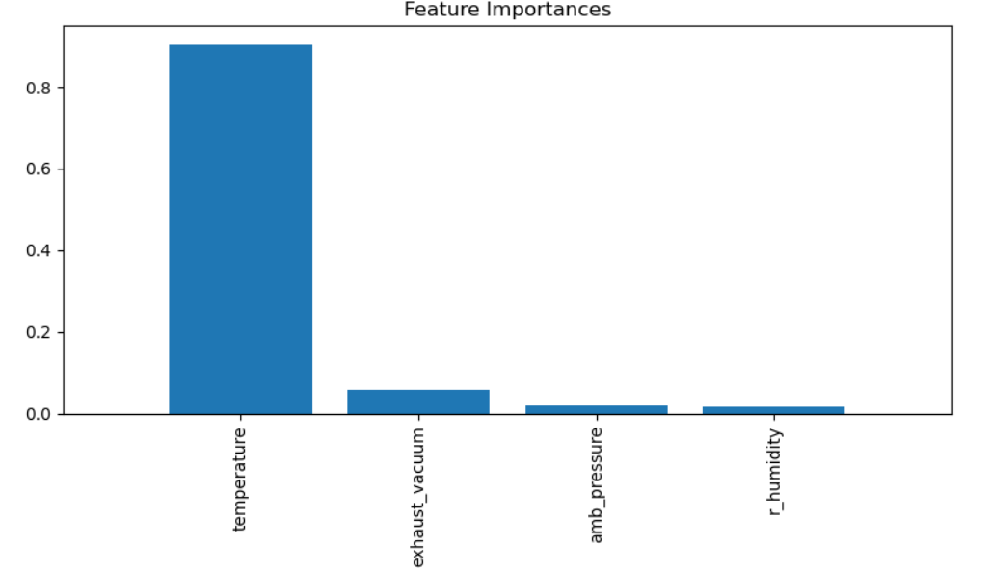
Feature selection with Decision Tree Regressor
Feature: temperature
Importance Score: 0.9044
Rank: 3
Is Significant: True
Feature: exhaust_vacuum
Importance Score: 0.0589
Rank: 2
Is Significant: True
Feature: amb_pressure
Importance Score: 0.0206
Rank: 1
Is Significant: False
Feature: r_humidity
Importance Score: 0.0161
Rank: 0
Is Significant: False

Slide 16
Model building with different regression models

Slide 17
MLR
With Duplicates and Outliers
dependent *energy_production*
r2:-0.9286960898122536
r2_Adj:- 0.9286662648994908
AIC :- 56186.22904743758
Removing Duplicates and Outliers
dependent *energy_production*
r2:- 0.9277425155023922
r2_Adj:- 0.9277118068391973
AIC :- 55345.53530507031

Slide 18
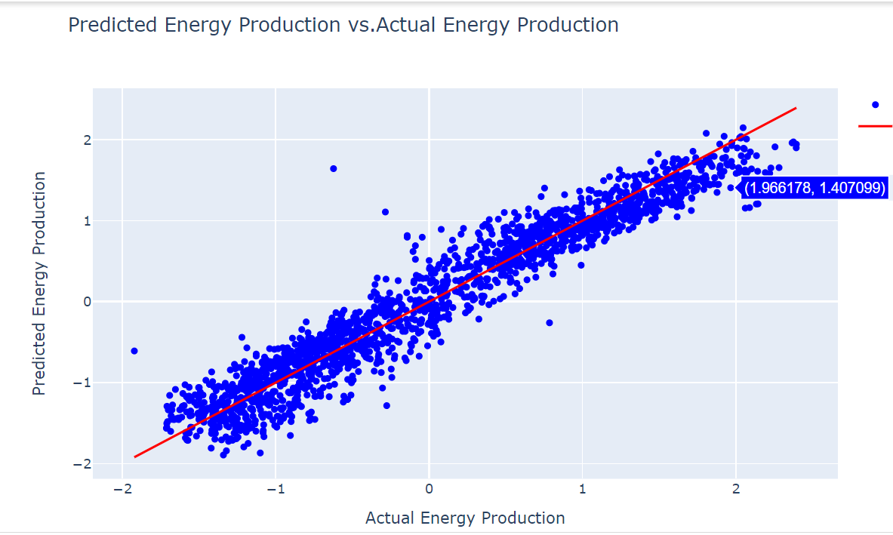
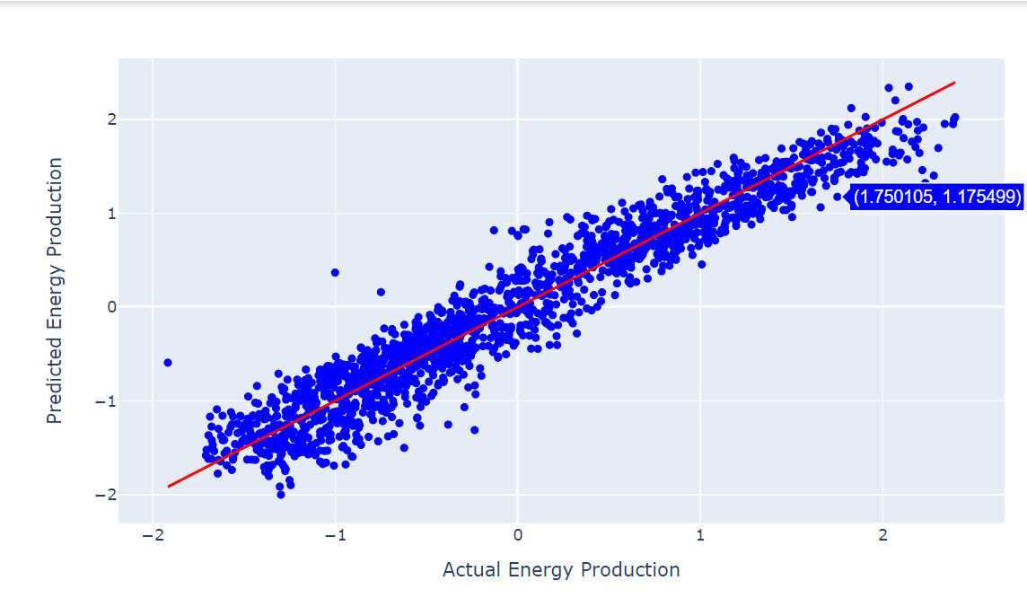
Support vector Regressor model building
With Duplicates and Outliers
Mean Squared Error: 0.072
R-squared Score: 0.931
Removing Duplicates and Outliers
Mean Squared Error: 0.069
R-squared Score: 0.929
SVR with linear kernel

Slide 19
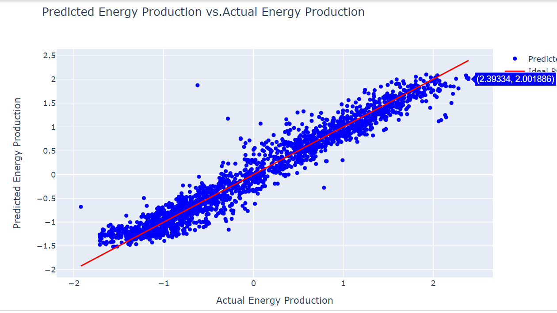
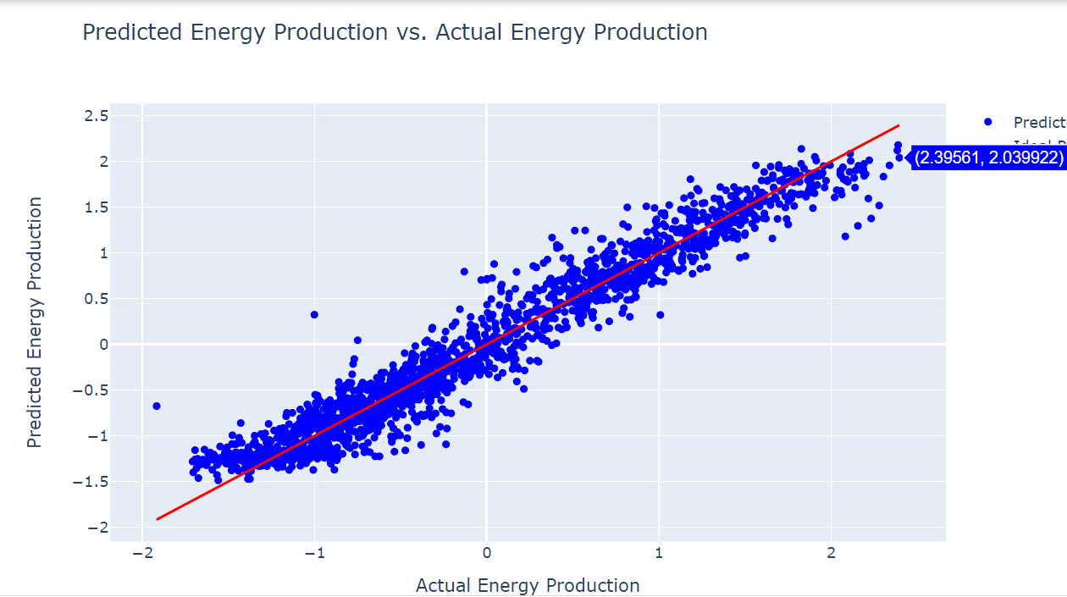
Support vector Regressor model building
With Duplicates and Outliers
Mean Squared Error: 0.057
R-squared Score: 0.945
Removing Duplicates and Outliers
Mean Squared Error: 0.052
R-squared Score: 0.946
SVR with RBF kernel

Slide 20
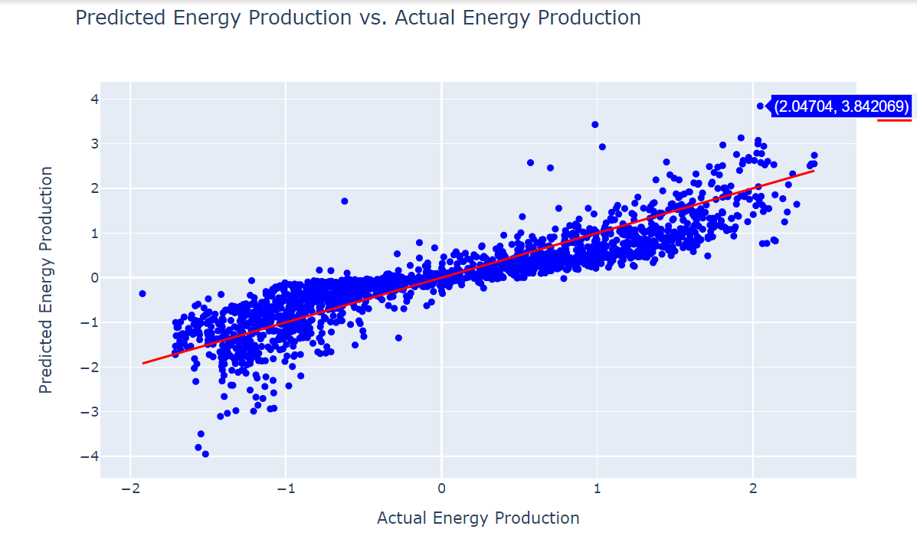
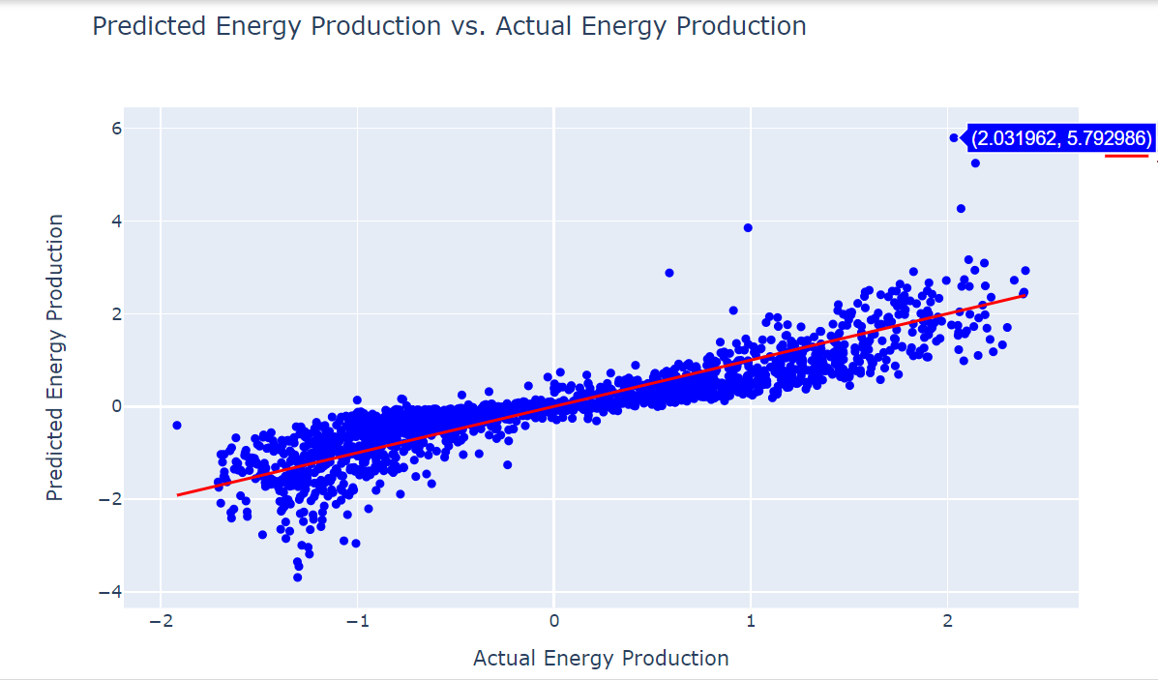
Support vector Regressor model building
With Duplicates and Outliers
Mean Squared Error: 0.216
R-squared Score: 0.778
Removing Duplicates and Outliers
Mean Squared Error: 0.223
R-squared Score: 0.786
SVR with Polynomial Kernel

Slide 21
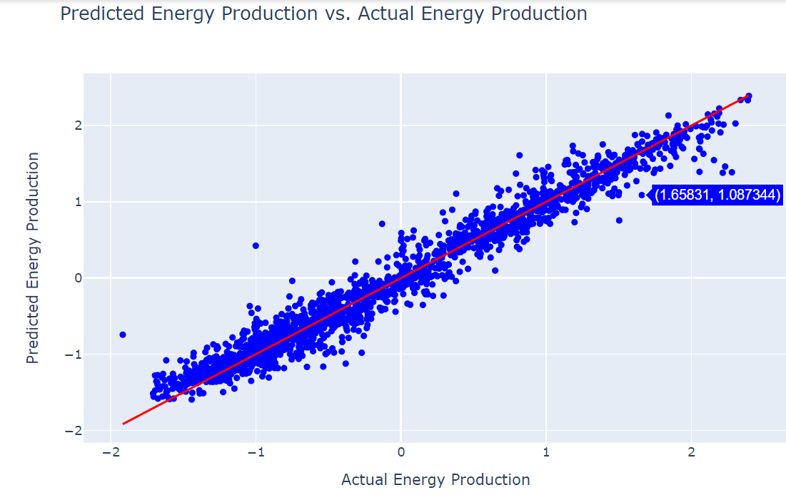
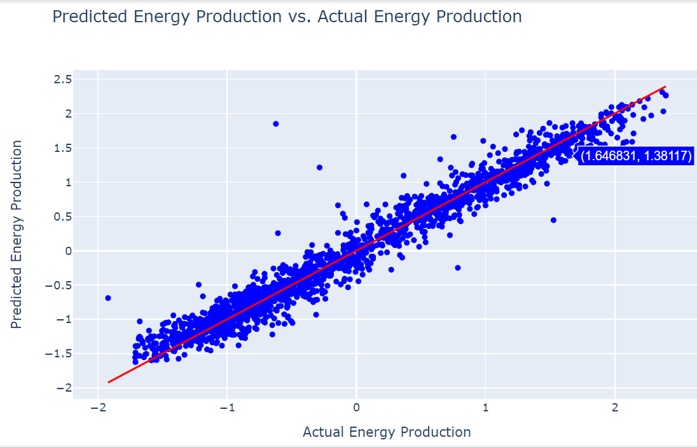
Random forest regressor MODEL BUILDING
With Duplicates and Outliers
Mean Squared Error: 0.0385
R-squared Score: 0.962
Removing Duplicates and Outliers
Mean Squared Error: 0.0362
R-squared Score: 0.962

Slide 22
Estimaters in Random forest regressor
With Duplicates and Outliers
Random Forest Model 1 –
Mean Squared Error (MSE): 0.062
Random Forest Model 1 –
R-squared Score: 0.94
Random Forest Model 2 –
Mean Squared Error (MSE): 0.043
Random Forest Model 2 –
R-squared Score: 0.958
Random Forest Model 3 –
Mean Squared Error (MSE): 0.038
Random Forest Model 3 -
R-squared Score: 0.963
Removing Duplicates and Outliers
Random Forest Model 1 –
Mean Squared Error (MSE): 0.058
Random Forest Model 1 –
R-squared Score: 0.94
Random Forest Model 2 –
Mean Squared Error (MSE): 0.04
Random Forest Model 2 –
R-squared Score: 0.958
Random Forest Model 3 –
Mean Squared Error (MSE): 0.036
Random Forest Model 3 –
R-squared Score: 0.963

Slide 23
Estimaters GridSearchCV with cross validation
With Duplicates and Outliers
Removing Duplicates and Outliers
Best Parameters: {'max_depth': None, 'n_estimators': 150, 'random_state': 42}
Best Model - Mean Squared Error (MSE): 0.038
Best Model - R-squared Score: 0.963
Best Parameters: {'max_depth': None, 'n_estimators': 150, 'random_state': 42}
Best Model - Mean Squared Error (MSE): 0.036
Best Model - R-squared Score: 0.963

Slide 24
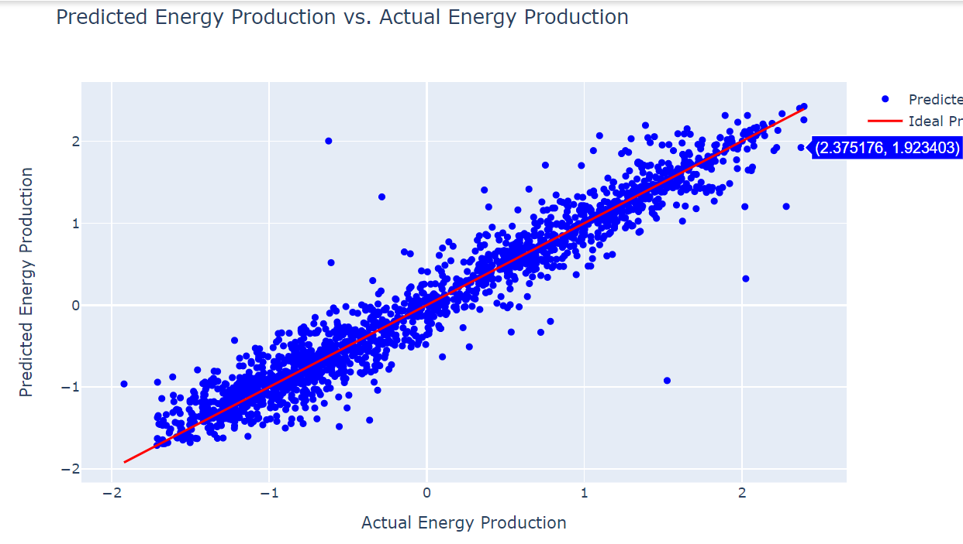
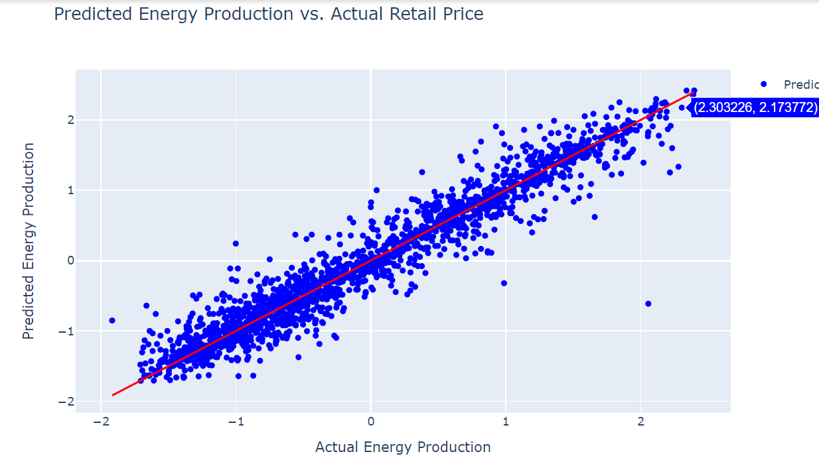
Decision Tree Regressor Model building
With Duplicates and Outliers
Mean Squared Error: 0.0649
R-squared Score: 0.937
Removing Duplicates and Outliers
Mean Squared Error: 0.0680
R-squared Score: 0.93009

Slide 25
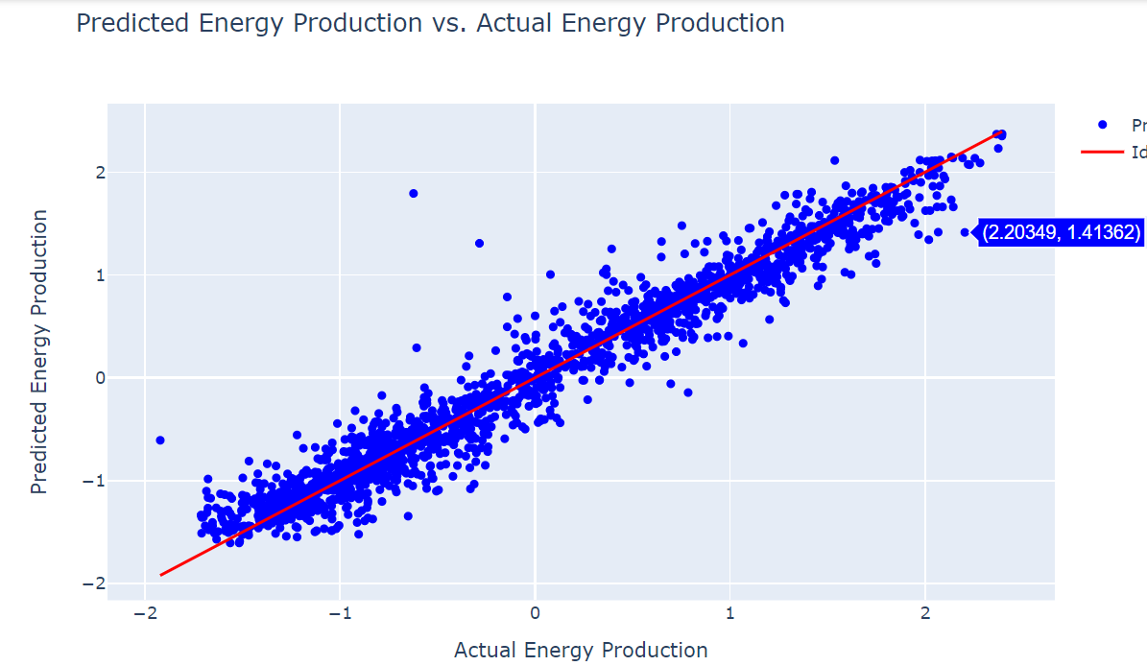
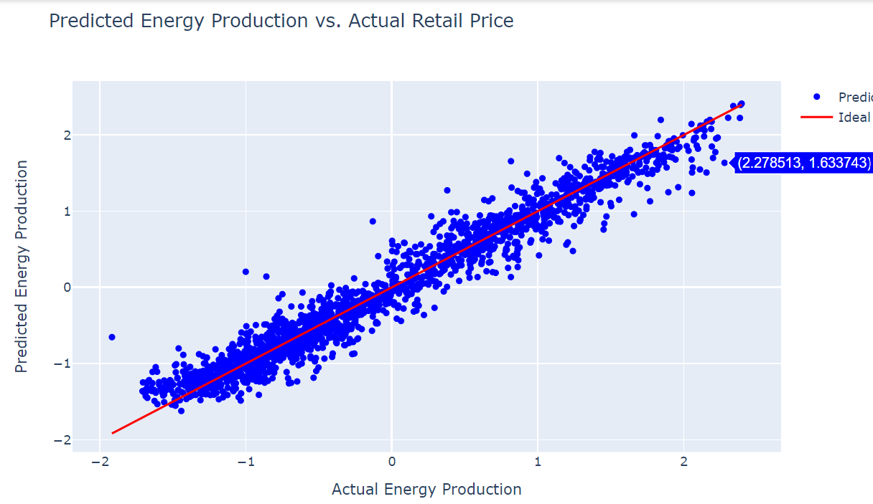
K-Nearest Neighbors (KNN) Regressor
With Duplicates and Outliers
Mean Squared Error: 0.051 R-squared Score: 0.951
Removing Duplicates and Outliers
Mean Squared Error: 0.046
R-squared Score: 0.953

Slide 26
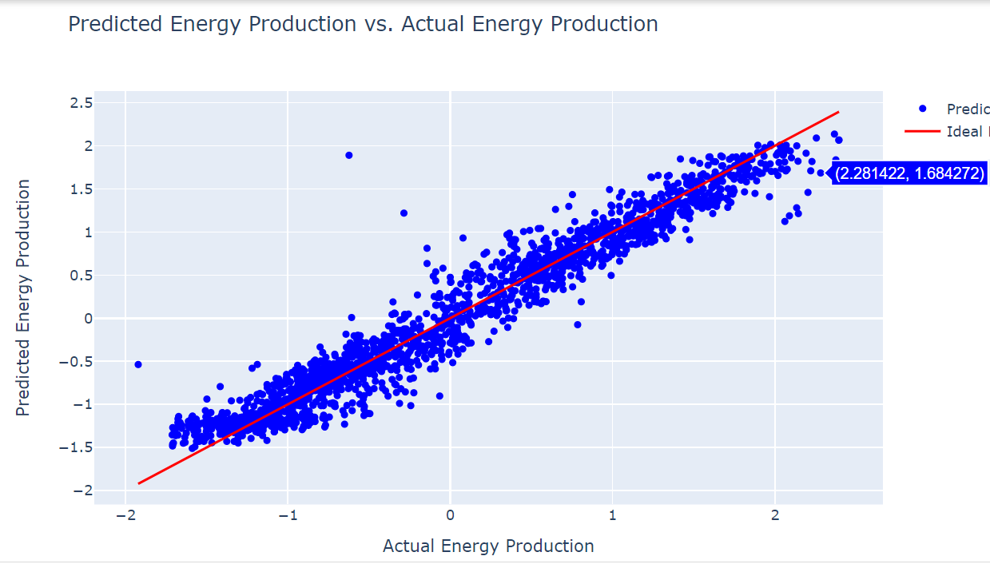
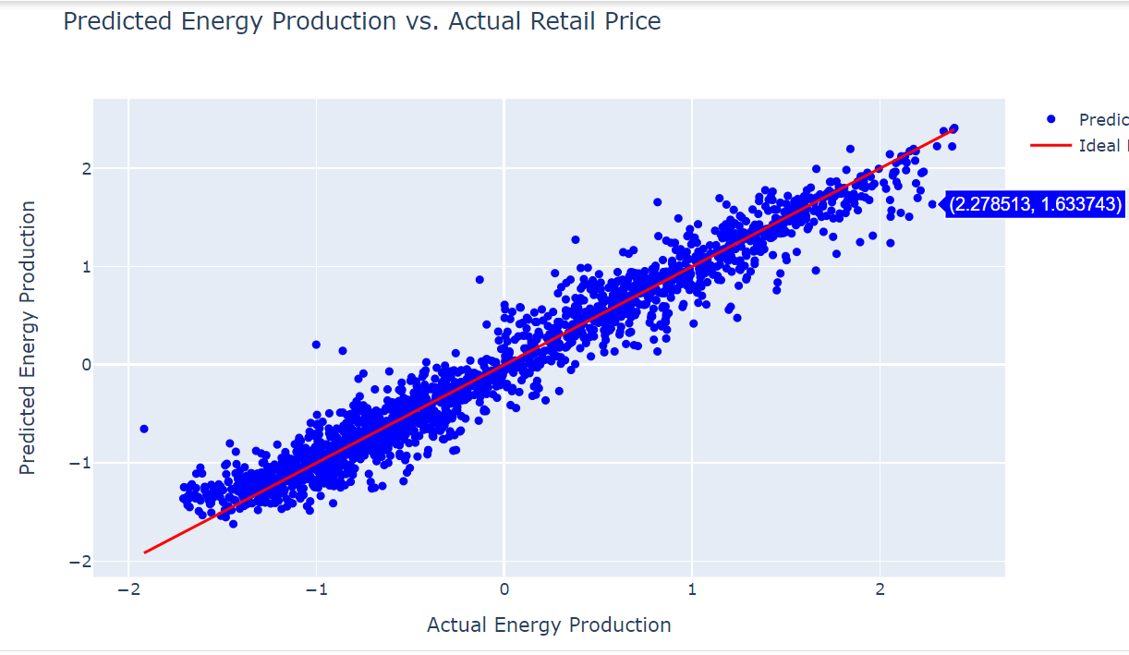
Boosting Techniques Gradient Boosting Regressor
With Duplicates and Outliers
Mean Squared Error: 0.053 R-squared Score: 0.949
Removing Duplicates and Outliers
Mean Squared Error: 0.046 R-squared Score: 0.953

Slide 27
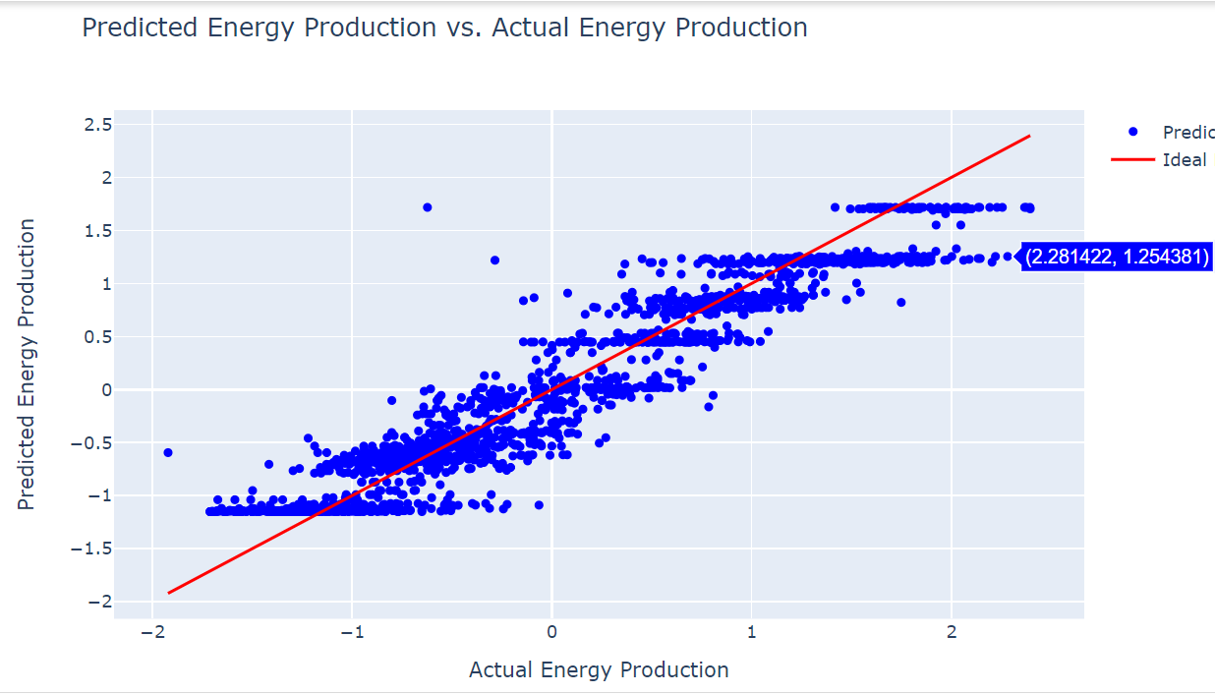
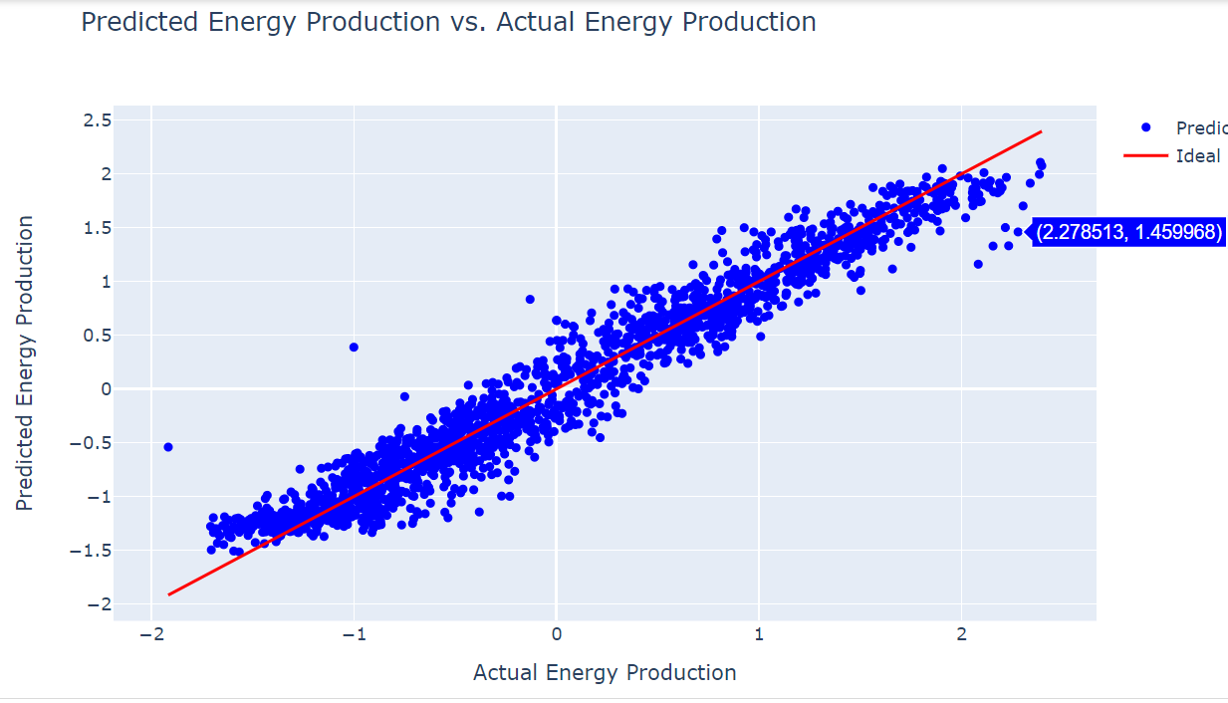
AdaBoost Regressor model
With Duplicates and Outliers
Mean Squared Error: 0.089 R-squared Score: 0.915
Removing Duplicates and Outliers
Mean Squared Error: 0.049 R-squared Score: 0.95

Slide 28
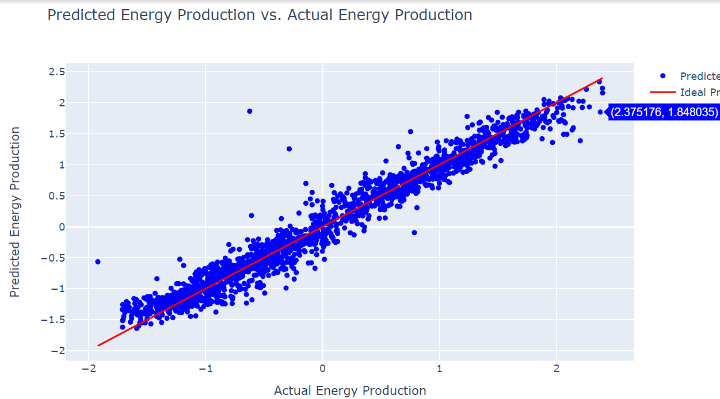
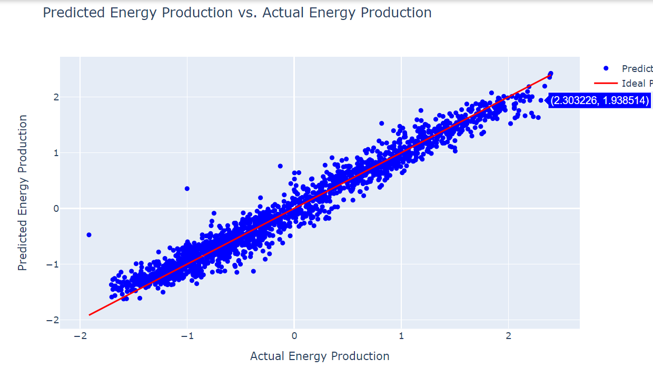
XGB Regressor model building
With Duplicates and Outliers
Mean Squared Error: 0.088 R-squared Score: 0.914
Removing Duplicates and Outliers
Mean Squared Error: 0.088 R-squared Score: 0.098

Slide 29
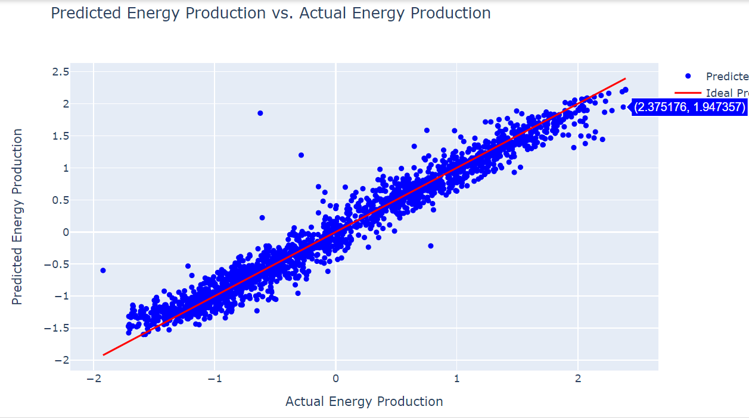
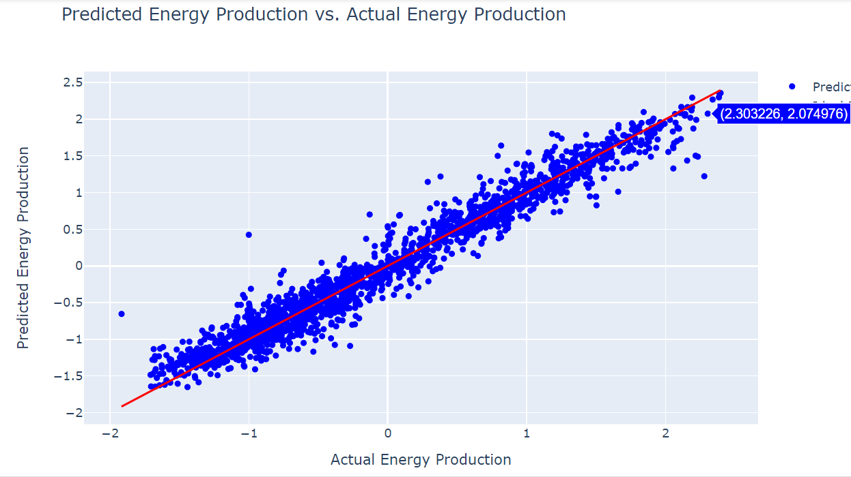
Bagging model building
With Duplicates and Outliers
Mean Squared Error: 0.0404 R-squared Score:0.961
Removing Duplicates and Outliers
Mean Squared Error: 0.0417 R-squared Score: 0.957

Slide 30
Finalizing Model Result :-
Random Forest Regressor :-
This model showcases robust predictive power with a low Mean Squared Error (MSE) of 0.0386 and a high R-squared score of 0.963, indicating its accuracy in explaining data variance. Its consistent performance across test data validates its reliability, making it a strong choice for making precise predictions in real-world scenarios.

Slide 31
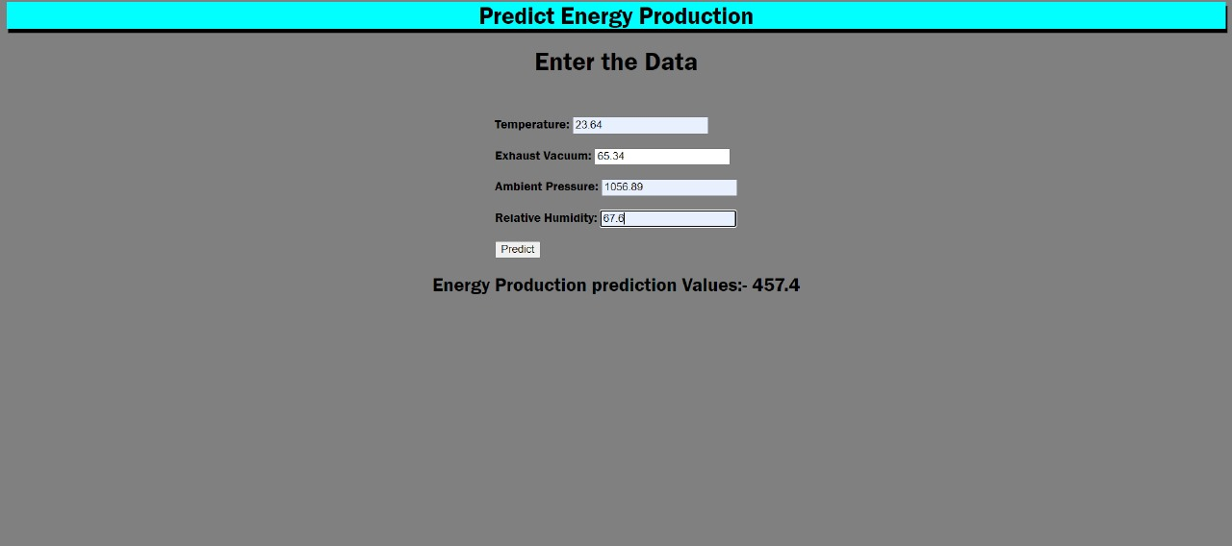
Model Deployment
We used model deployment FLASK with HTML
So that we used for importing flask, request, render template before creating the model.pkl by importing pickle, which helps us to create a deployment folder and web application with HTML.

Slide 32
Challenges faced ? How did you overcome?
When we navigating the combined-cycle power plant RESEARCH posed multifaceted challenges.
Balancing data complexities while employing N-estimators demanded has different accurates. Achieving an accurate R2 score and minimizing MSE required iterative model refinement. Integrating Flask for model deployment added another layer of intricacy.
Persistence and strategic problem-solving were crucial in overcoming these hurdles.
Continuous learning and adaptability paved the way for refining methodologies, ultimately enhancing model accuracy and streamlining Flask deployment.

Slide 33
Thank You

